Slide 1
Where Did My Money Go?
Understanding the Money You Earn

Slide 2
Herbert Mason: Talent Development & Training Manager
26 Years in Retail Banking
In Process: Masters Industrial/Organizational Psychology
Bachelors Science in Business
Under Grad Certification in Human Resource Management
Associates in Criminal Justice
Graduate The New England School of Financial Studies
Certified Emotional Intelligence Instructor
Certified in Integrated Talent Management & Designing & Managing Learning Programs
Discover Museum Boad of Director & Chair of their People Task Force

Slide 3


Slide 4
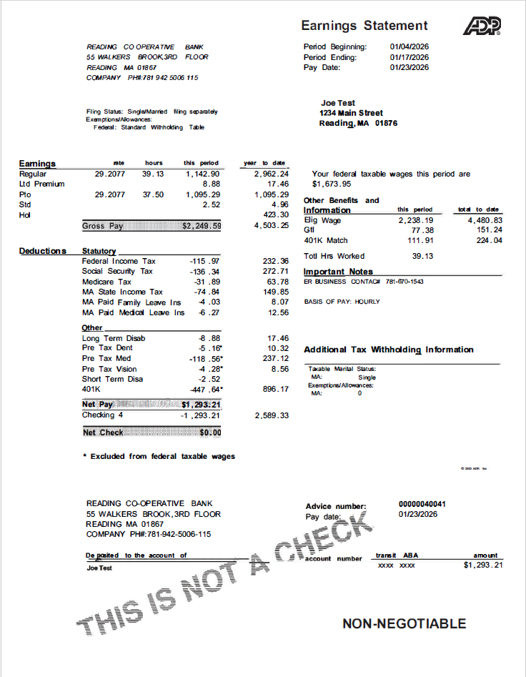
Making Sense of it All
Earnings
Deductions
Other Benefits & Information

Slide 5
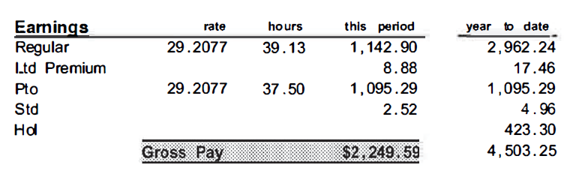
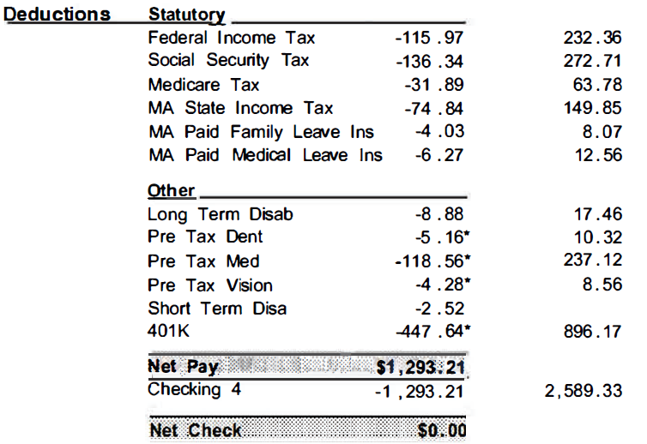
Making Sense of it All

Slide 6

Net Pay
Determines your real spending power.
What you actually can live on
Knowing your net keeps your bank account from surprising you

Slide 7
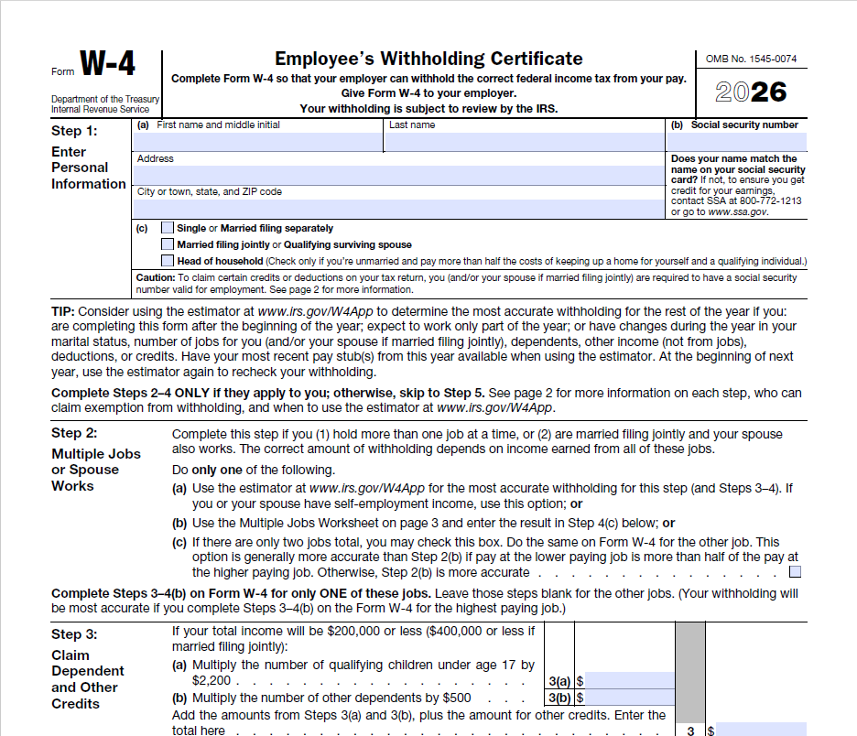
W4
How much tax to take out
Calculates your Net Pay

Slide 8
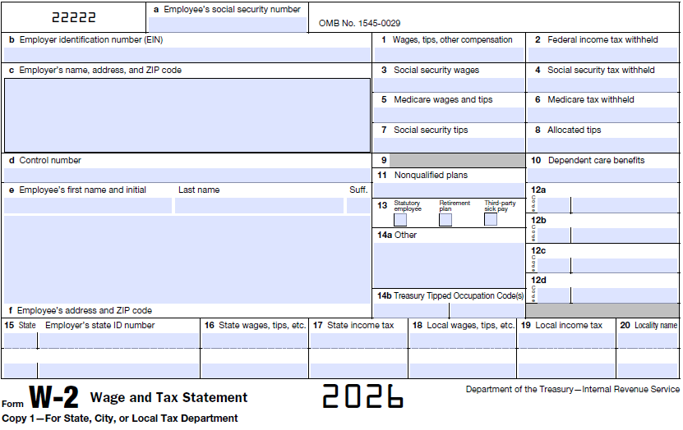
W2
Lists Toal Earnings
Lists Paid Taxes
If you want your money, you need your W2!!!

Slide 10
Team Challenge – Where did my money go?
Sam earned $1,000 this gross pay period but only took home $780. Where did the missing money most likely go?
The employer stole it Taxes and deductions Sam miscounted hours Direct deposit error
Two coworkers have the same job and work the same hours. One takes home more money per paycheck. What best explains this?
One worker is cheating the system Payroll made a mistake Their benefits or W‑4 choices are different One negotiated secretly

Slide 11
Team Challenge – Where did my money go?
Jordan wants a bigger paycheck every pay period and doesn’t care about a big refund. What best supports that goal?
Increase 401(k) contribution Add extra withholding Reduce tax withholding on the W‑4 File taxes early
In January, Mia sees a form showing her total earnings and taxes paid last year. Which document is this?
Paystub W‑4 W‑2 Offer letter

Slide 12
Team Challenge – Where did my money go?
Chris just signed up for health insurance and a 401(k).Their paycheck is now smaller. Which statement is most accurate?
Chris is losing money Payroll made an error Some money is going to future benefits Taxes doubled
Taylor works two part‑time jobs and never updated the W‑4. What is Taylor MOST at risk for?
Bigger refund Smaller paychecks Owing money at tax time Lower hourly pay

Slide 13
Team Challenge – Where did my money go?
Which deduction below is NOT optional for most workers?
401(k) Health insurance Federal income tax Transit benefits
A job offer says: $24/hour. Why is this number NOT the best way to plan a budget?
It sounds better than it is You don’t get all of that money Taxes change daily It doesn’t include bonuses

Slide 14
Team Challenge – Where did my money go?
You want to avoid owing the IRS next year. Which tool helps you most during the year?
W‑2 Paystub W‑4 Bank account
In ONE sentence: Where does your money go on a paycheck? Be creative.
???????????????

